Slide 1
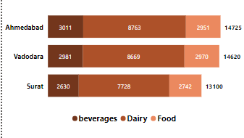
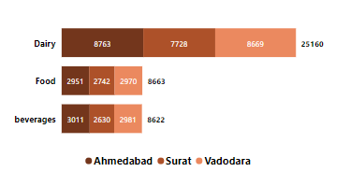
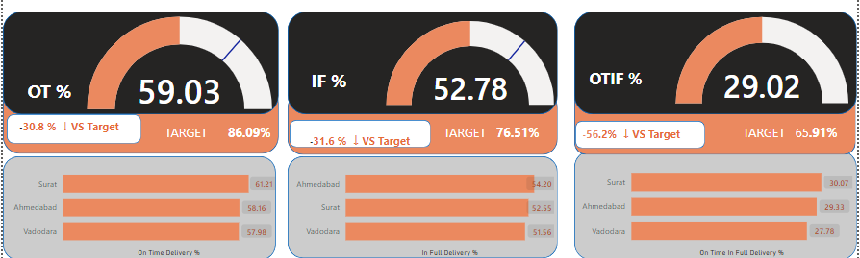
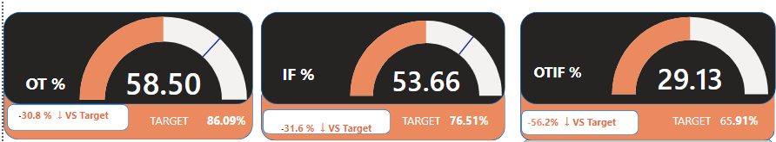
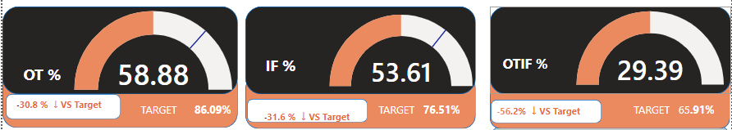
1) Diary products orders are almost double than the Food and Beverages Category.
2) First 6 Customers Acclaimed Stores , Lotus Mart, Vijay Stores, Rel Fresh, Cool Blue & Propel Mart is constituting 53% of Total orders & seems to be key customers
3) Average OT%, IF% and OTIF% are noticeably lower than the Targeted levels.
4) MARCH’22 and AUG’22 are the two months where IF% and OTIF % have shown slight improvement compare to past month, still they are far away from Target levels

Slide 2
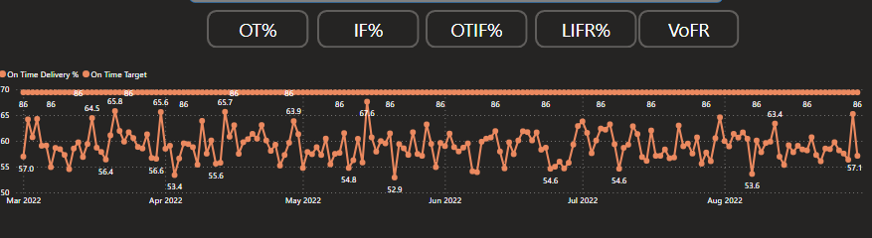
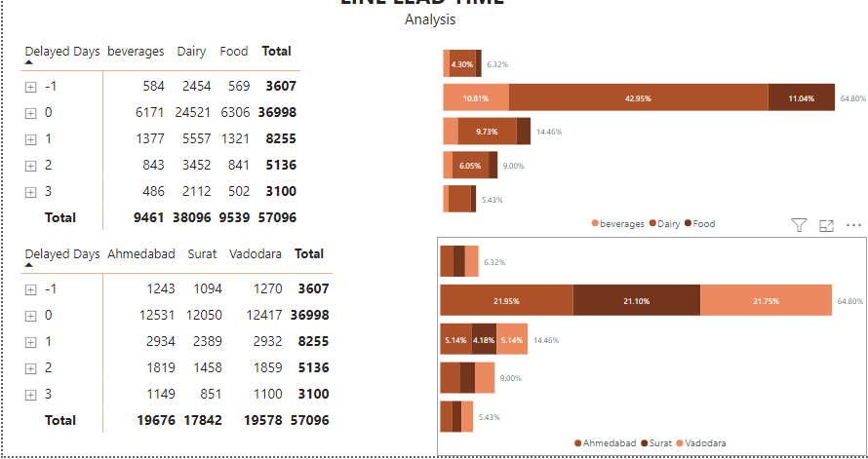
In Daily Trend for OT% Graphs for Order even Daily level of OT% too are significantly lower than Targeted OT% As we see in above slide only 59.03% of total orders are delivered on time
Even Daily trends of IF% and OTIF % chart shows that not a single day they are able to touch the Target lines for respective matrices . Especially OTIF% performance is quite disappointing. The average OTIF% is significantly lower than the Targeted OTIF % Which shows poor delivering capabilities.
Initial analysis of Order Line overview shows that there are certain customers who has LIFR % noticeably lower than Average LIFR%. • Acclaimed Stores , Cool Blue, Elite Mart, Info Stores, Lotus Mart, Sorefoz Mart & Vijay Stores • Out of That Acclaimed Stores , Lotus Mart & Vijay Stores are the customers who have larger no. of order lines amongst all 12 Further detailed analysis of Line lead time analysis combined with delayed days analysis reveals some interesting facts For Acclaimed Stores , Cool Blue & Lotus Mart more than 75% of times lines are being delivered late. Moreover, out of that 75% delayed deliveries, 66% of them are late by 2 or 3 days.

Slide 3
